Slide 1
Exercise 1
Reversing Linked List
https://pintia.cn/problem-sets/16/problems/664
Slides adapted from material by Profs. Chen Yue(Zhejiang University)

Slide 2
问题描述
Given a constant K and a singly linked list L, you are supposed to reverse the links of every K elements on L. For example, given L being 1→2→3→4→5→6, if K = 3, then you must output 3→2→1→6→5→4; if K = 4, you must output 4→3→2→1→5→6.

Slide 3
输入输出格式
Input Specification:
Each input file contains one test case. For each case, the first line contains the address of the first node, a positive N (<= 10⁵) which is the total number of nodes, and a positive K (<=N) which is the length of the sublist to be reversed. The address of a node is a 5-digit nonnegative integer, and NULL is represented by -1.
Then N lines follow, each describes a node in the format:
Address Data Next
where Address is the position of the node, Data is an integer, and Next is the position of the next node.
Output Specification:
For each case, output the resulting ordered linked list. Each node occupies a line, and is printed in the same format as in the input.

Slide 4
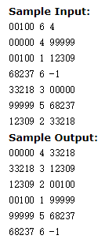

输入输出示例
起始地址 结点数 需要翻转的子链长度

Slide 5
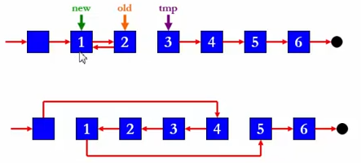
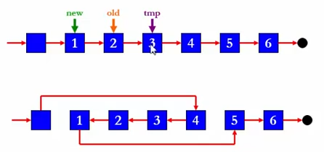
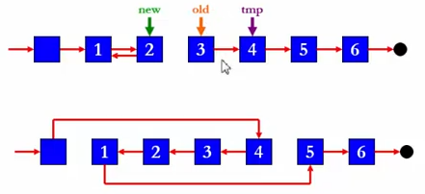
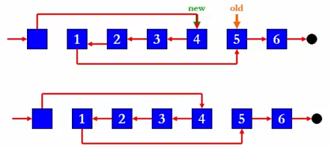
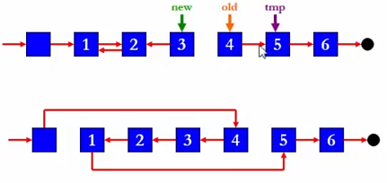
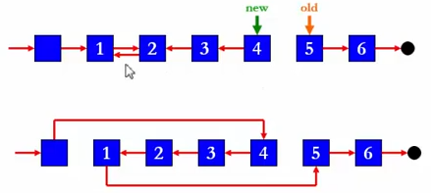
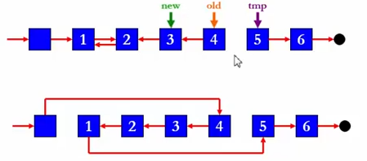
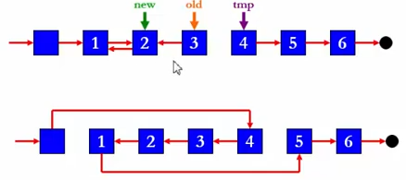
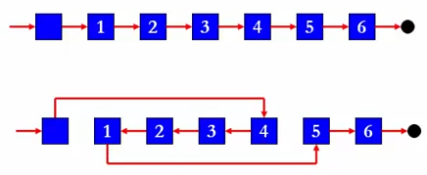
分析
new ：新的、已经逆转好的链表头结点
old： 还未完成逆转的链表部分的头结点
tmp： 临时指针，别断了链表

Slide 6
核心伪代码
Ptr Reverse( Ptr head, int K )
{
cnt = 1;
new = head->next;
old = new->next;
while ( cnt < K ) {
tmp = old->next;
old->next = new;
new = old;
old = tmp;
cnt++;
}
head->next->next = old;
return new;
}

Slide 7
完整代码
完整代码实现

Slide 8
关于程序测试样例
以上例说明：
有尾巴不翻转
测试数据包含上下界
正好能全翻转，i.e.，N%K==0
K==N
K==1
最大（最后升K-1不翻转）、最小N
有多余、不属于链表的结点

Slide 9
Data Structures
To be continued…

